Slide 1
NewsFeed
Chris Jacob Bobby

Slide 2
Goals
Mobile application to provide a user with their prefered news from over 70 sources
Machine Learning analysis of each article
Machine learning analysis of trending/top topics
History of articles viewed and user preferences

Slide 3
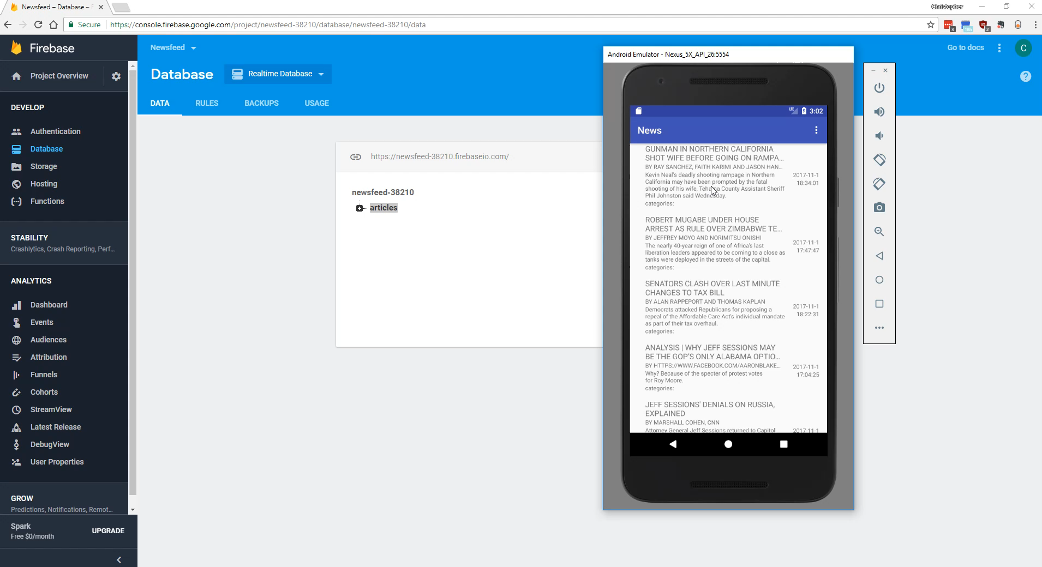
Video Demo

Slide 4
Work done so far
Chris
I did the initial configuration for firebase and researched a more permanent configuration for the API keys, and how to handle multiple queries.
implemented QueryUitl.java functions to query sources
implemented SourceLoader.java, Entity.java and put all the models under model

Slide 5
Difficulties so far
Figuring out the best to use three separate RESTapi calls without impacting performance

